Slide 1

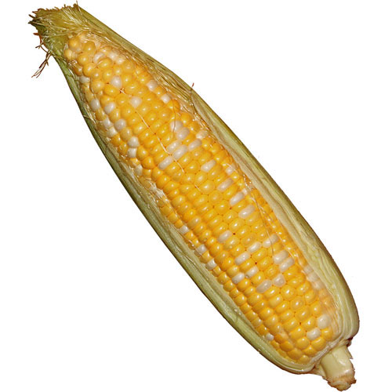
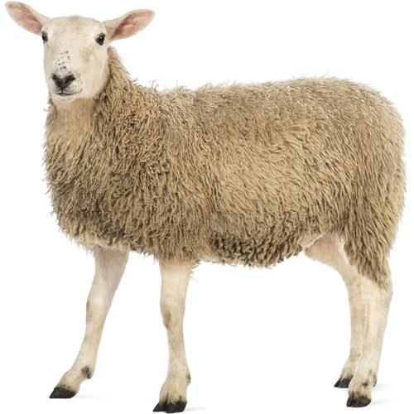
Object #1
Object #2
Object #3
Respond within 4s:
“Y” or “N”
Delay
+
Test Object
Trial Time

